Slide 1
An Introduction to AI
Jackson Baldwin, Molly Meadows and Conner Mullins

Slide 2
Table of Contents
What is AI?
Types of AI in Unity
Live Demo: A* Pathfinding
Demo Modes
Deadlines

Slide 3
What is AI?
Artificial Intelligence
“1 : a branch of computer science dealing with the simulation of intelligent behavior in computers. 2 : the capability of a machine to imitate intelligent human behavior.” - merriam-webster
A computer program/object that can perform functions independently based on a system of instructions
Mimicry of human intelligence
Notes:
Coined by John McCarthy in 1955, but the

Slide 4
4 Types of AI
Reactive:
Programmed to provide an output based on some input. No way to learn from/of past or future actions
Ex. IBM’s Deep Blue
Limited Memory:
Learns from the past and builds experiential knowledge by observing actions or data
Ex. Chatbots
Theory of Mind:
Behavior will adjust based on emotions, which will change as it interacts with people
(work in progress)
Self-Aware:
Most advanced type, are aware of their own emotions and will have both desires and needs
(conceptual)

Slide 5
Different Classification of Types of AI
Artificial Narrow Intelligence (ANI)
All current forms of AI
Can only do what they are programmed to do
Machine Learning
Artificial General Intelligence (AGI)
Can learn, understand, perceive and function just as a human would
Artificial SuperIntelligence (ASI)
Most capable forms of intelligence
More capable than humans

Slide 6
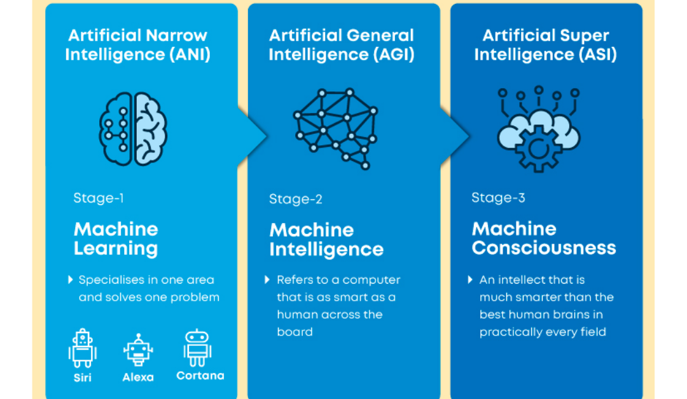

Slide 7
How Does it Work?
AI systems combine large sets of data with processing and complex algorithms that will allow the program to learn from features or patterns to provide specific functionality
Six Subsets:
Machine Learning
Deep Learning
Natural Processing Language
Robotics
Neural Networks
Genetic Algorithms
Notes:
Machine Learning is a subset of AI that

Slide 8
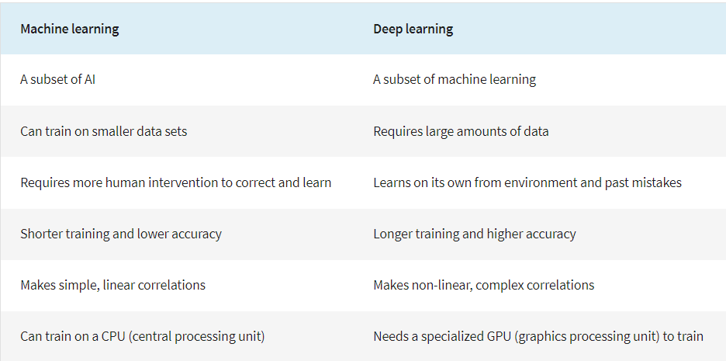
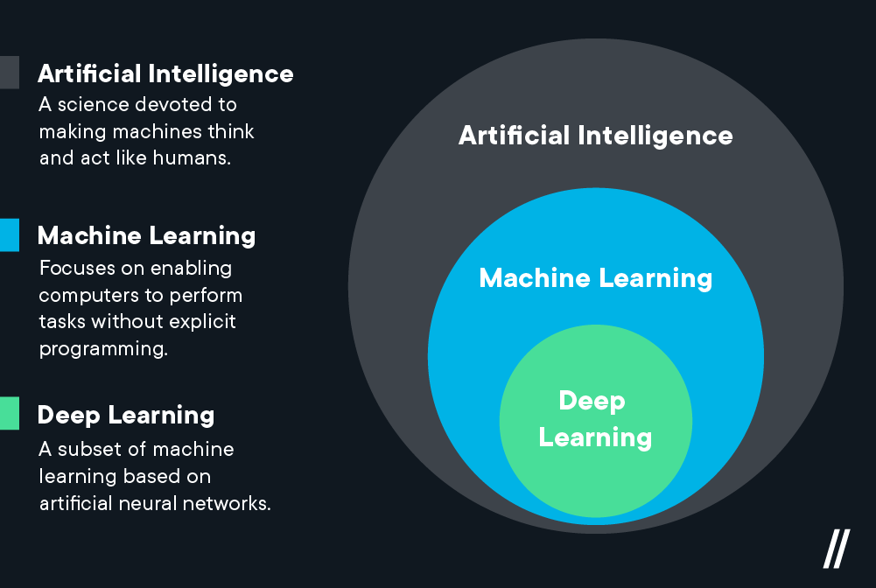
Machine Learning vs Deep Learning
Notes:
The majority of narrow AI is powered through machine learning and deep learning. Machine learning simply put is AI that can adapt its output with little human interference once given the algorithms and deep learning uses artificial neural networks to mimic the human brain process to solve issues. “The neural networks contain a number of hidden layers through which the data is processed, allowing the machine to go “deep” in its learning, making connections and weighting input for the best results”
Good example for comparison is GPS (ML) compared to Self-driving cars (DL). ML learns from data using algorithms and patterns. DL has algorithms with hidden layers to make connections with multiple inputs to learn at a deeper level.

Slide 9
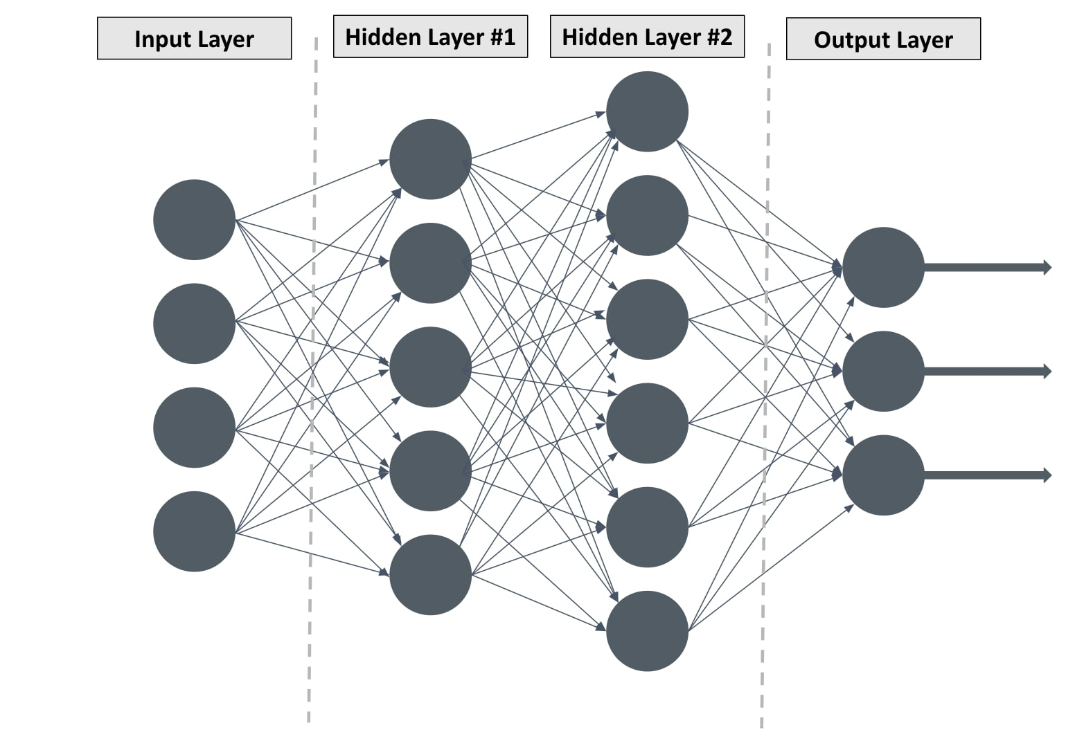

Slide 10
Popular Examples/Uses
AI art generator
Google Photo Translate
Self Driving Cars
Chatbots
Cortana/Siri/Google Home/etc.
GPS
Autocorrect
HealthCare Apps
Agriculture Statistics
Customer Support
Social Media
Facial Recognition (Security)
E-Commerce

Slide 11
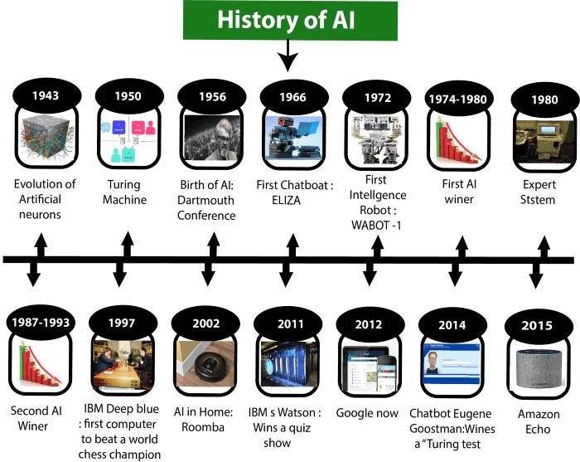
Timeline of Important AI Events
Notes:
1943: Warren McCulloch and Walter pits in 1943. They proposed a model of artificial neurons: neural architecture that receives input, and produces output based on a procedure
Turing machine: symbols on a tape according to a set of rules
1956: coined the term AI John McCarthy

Slide 12
Why is AI Important?
More reliable and less errors
Fast data analysis
24/7 access
Many more!

Slide 13
How can AI be used Unethically
AI search results
The self-driving car dilemma
Using AI art algorithms to copy and sell fakes/copyright issue?
Recruiting algorithms could be made to exclude certain groups
Privacy concerns
Golden State Killer
Notes:
AI can often uphold stereotypes held by society in portraying search results. Often, the websites that are displayed first in your engine searches are the sites that have the most clicks, which in some cases can uphold sites that have unethical biases.

Slide 14
Types of AI in Unity
A* Pathfinding
NavMesh
Behavior Trees
Machine Learning (ML Agents)
State Machines
Bolt

Slide 15
Live Demo:
A* Pathfinding

Slide 16
Demo Modes!

Slide 17
What is a Game Demo?
A game demo is a way for a company to show off core features of a video game in a short period of time
…interactable, visual, auditory
…way to experience a video game with little/no knowledge
Demos are incredibly important to improve your games visibility to a market and improve sales rate.
…get people interested in the game before the full release

Slide 18
3 Types of Game Demos
Overview Demo
…made in the initial stages of development. It shows all the features of your game design and gives an overviewing explanation of your game…a “guidebook” to the game and its rules
…great for early development projects and incremental updates, not fantastic for showing off how the final product will end up
Live Demo
Trial Version Demo
…small-scale, fully playable version of the video game.
…most interactive way to show off a product and usually receives the most attention from potential buyers, but is only possible if game is developed enough to allow for it.
Notes:
Overview Demo:
sometimes used to showcase improvements made to the game as development progresses

Slide 19
Live Demo
…usually involves a dummy playthrough of a game, guiding the audience to see the details of gameplay and story.
…good way to showcase the graphics, movement, and tone of the game
Notes:
Overview Demo:
sometimes used to showcase improvements made to the game as development progresses

Slide 20
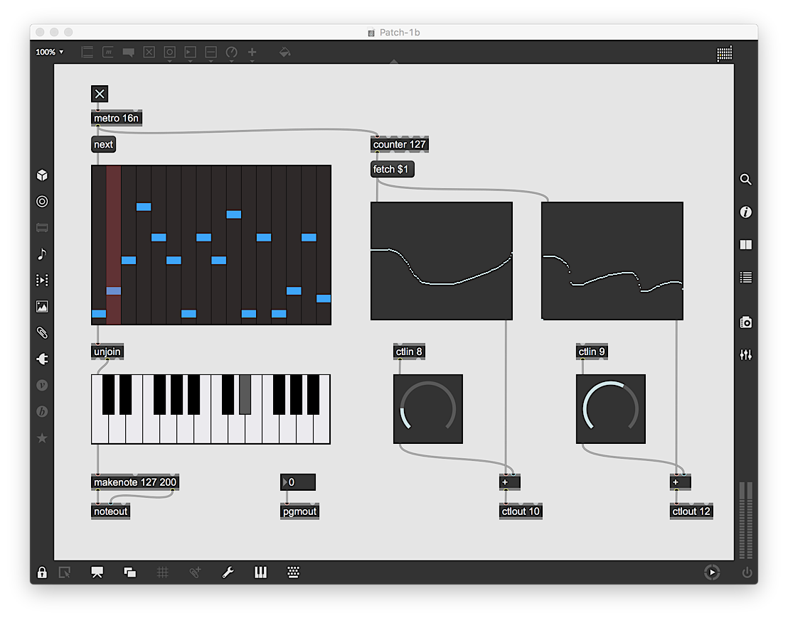
AI in Music (optional slide)
Max
…visual programming language for music and multimedia
…utilizes randomizers, visualizers, and modular synthesizers
https://youtu.be/08uCNNtuoN8
…AudioLab visualizer
https://www.youtube.com/watch?v=84_6gIa1n6c
…audio-reactive particles
Notes:
Overview Demo:
sometimes used to showcase improvements made to the game as development progresses

Slide 21
Upcoming DeadLines
November 3rd: Team Lead 5 Update
November 8th: Team Lead 6 Presentation
November 10th: Team Lead 6 Update
November 15th - 17th: Oral Exams
November 29th: Team Lead 1 Update
December 1st: Ethics Exam
December 6th: Post Mortem
December 8th: Final Demo

Slide 22
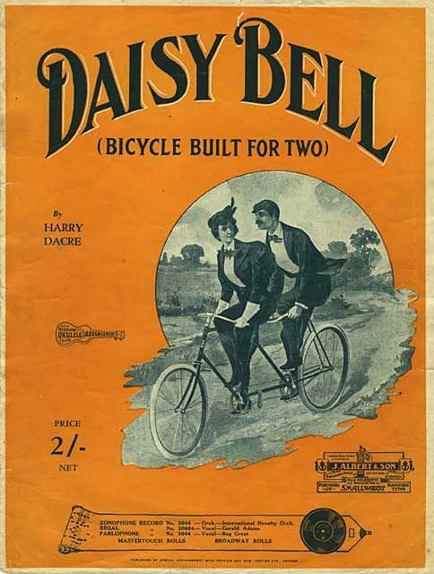
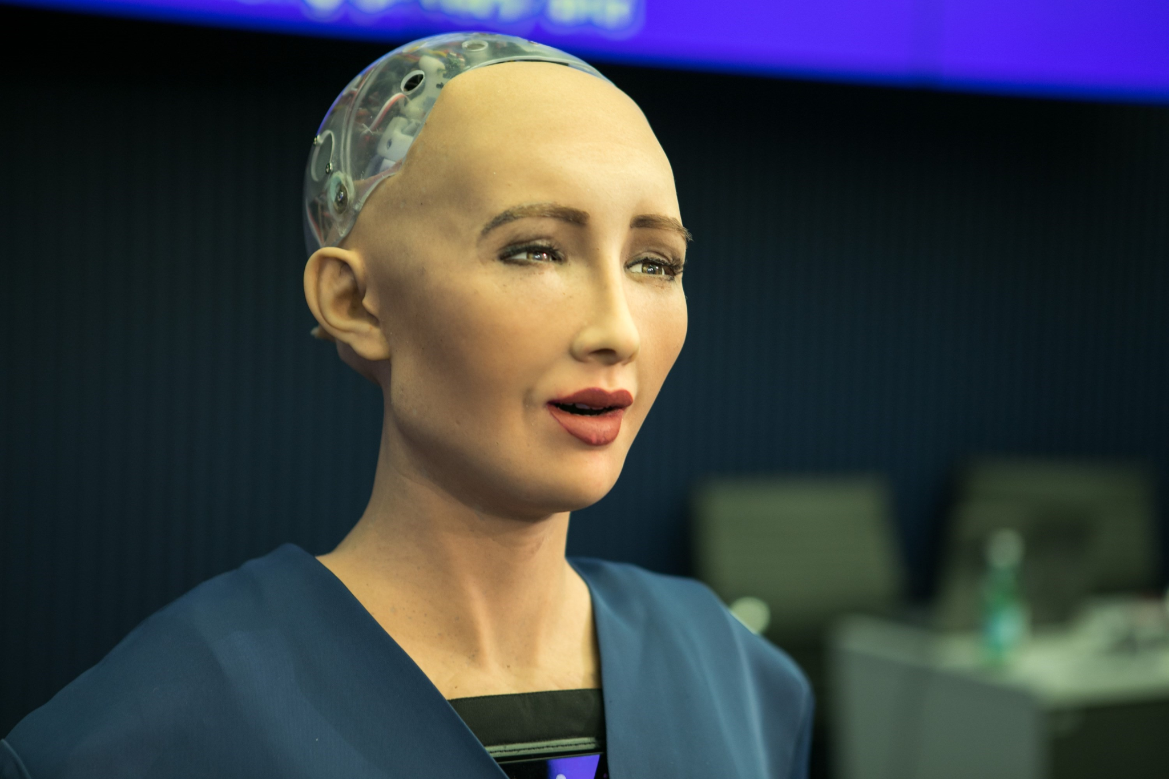
Other Examples
First computer to sing: Daisy Bell https://www.youtube.com/watch?v=41U78QP8nBk
Unethical and helpful uses in detective units: https://youtu.be/KrN2g-2LN7I
Sofia: First Humanoid Robot

Slide 23
Works Cited
https://www.investopedia.com/terms/a/artificial-intelligence-ai.asp
https://bernardmarr.com/understanding-the-4-types-of-artificial-intelligence/#:~:text=According%20to%20the%20current%20system,mind%2C%20and%20self%2Daware.
https://www.linkedin.com/pulse/understanding-4-types-artificial-intelligence-ai-bernard-marr#:~:text=The%20most%20basic%20type%20of,conceive%20of%20past%20or%20future.
https://www.sas.com/en_in/insights/analytics/what-is-artificial-intelligence.html#:~:text=AI%20works%20by%20combining%20large,or%20features%20in%20the%20data.
https://gamedevacademy.org/best-unity-ai-tutorials/
https://flatironschool.com/blog/deep-learning-vs-machine-learning/
https://www.hdatasystems.com/blog/importance-and-benefits-of-artificial-intelligence

